Slide 1
Project Proposal: Implement Simultaneous Localization and Mapping (SLAM) with MATLAB Reporter: Yuchen Song(宋雨辰) Team Members: Ruoyao Tian(田若瑶), Run He(何润), Rui Qi(齐睿), Jialong Zeng(曾嘉龙)
Theory and Technology of Robotics

Slide 2
Contents
1. Introduction of the problem
2. Formulation of the problem
3. Methods, Toolbox, and Software
4. Schedule

Slide 3
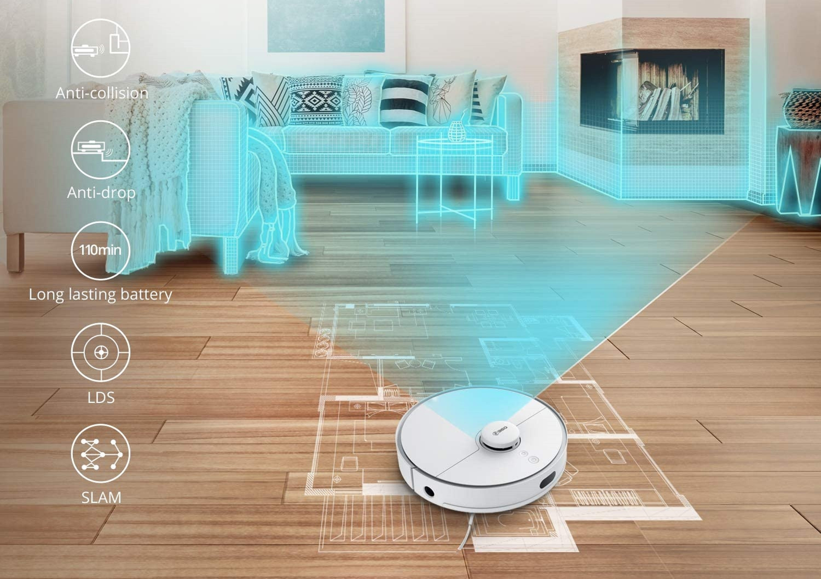
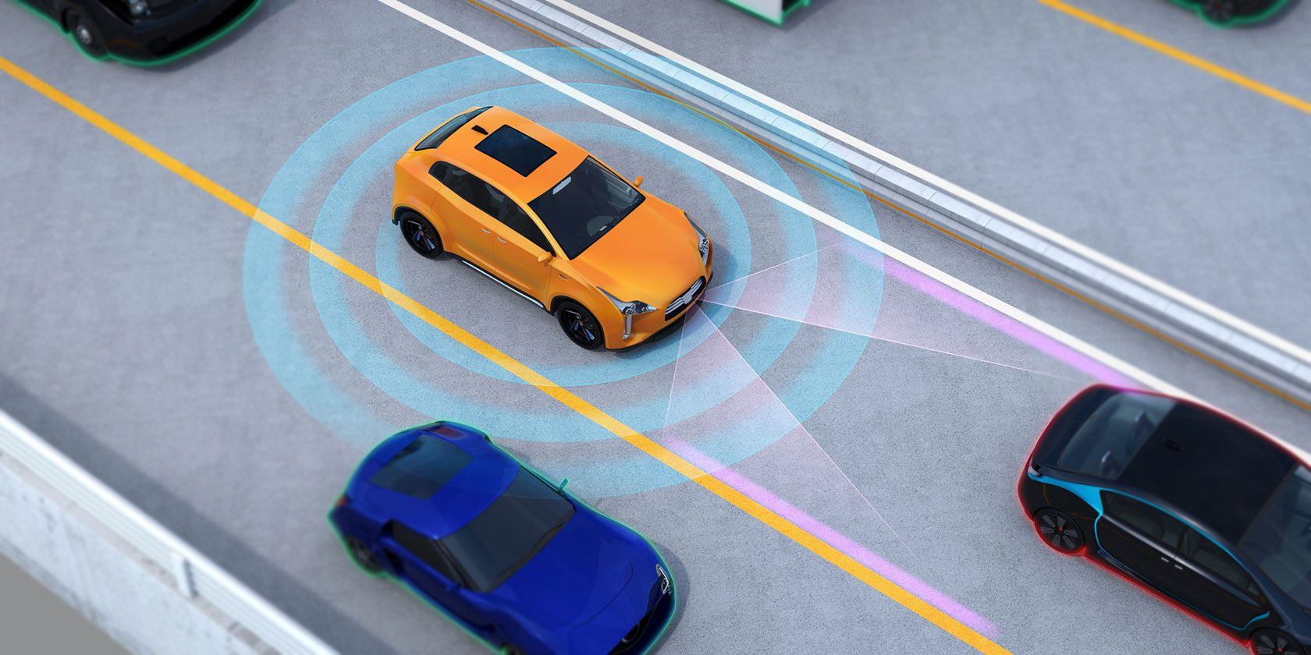
1. Introduction of the problem
Explore an unknown place
Localizing, mapping and navigating
Autonomous driving vehicles

Slide 4
2. Formulation of the Problem (take VSLAM for example)
Laser Radar: reflected energy, the amplitude, frequency, and phase of the reflected spectrum
Sensors
Loop closure
Information from outside
Camera: image
Reduce the cumulative error
correct the current pose
Sensor data processing
Image or Point cloud
VSLAM
Feature Detection
Harris, SIFT, BRISK, ORB
Front-end Processing of LOAM-SLAM is the same as the processing of VSLAM, the only difference is the algorithm
Front-end Processing
“Visual odometry”
Feature Matching
Template matching
Pose Estimation
PnP, BA
Pose of camera/vehicle
Back-end Processing
Reduce data noise
Update coefficients
Optimization
Kalman Filter/Extended Kalman Filter
Graph-based optimization
Map
Pose
Final output
Notes:
以视觉slam为例子，简要叙述了slam的基本实现流程
利用传感器感知外界环境信息，获得反射谱的能量、频率、幅值和相角；如果用摄像头，就是一帧一帧的图像
数据预处理：比如视觉去除一些椒盐噪声等等，前前前端的处理，模块内估计都已经做好了
特征提取与匹配：对于图像，特征点保证鲁棒性，使用哈里斯，SIFT等等角点检测，或者是ORB。匹配是匹配特征点，特征点可以是路标的，也可以是有区分度的物体的。
位姿估计：根据已经匹配的特征点，会返回一些有用的匹配结果（比如在图像坐标系的落点），利用它可以估计出摄像头（这里就是视觉了）的位姿（坐标系变换）
初步位姿估计需要后端算法优化，这里才是我们说的卡尔曼，扩展卡尔曼，图优化，粒子滤波等等，他们基本上都是基于初步估计值对参数更新（比如卡尔曼增益），然后再修正位姿，在噪声条件下获得较优秀的结果的算法。
根据需要计算输出图和位置，后面也可以进行轨迹规划
回环检测：检测过去图像或信息，可不可以与新的信息建立联系，如果可以，直接根据过去帧或者过去信息进行估计就可以，避免了误差的累积。检测就是检测旧的信息和最新的信息有无关联，抽象的化就是检测是否该位置已经经过。

Slide 5
2. Formulation of the Problem
Environment
Information collection
Image/amplitude/frequency/phase
Data association
(Feature detection and matching)
Loop closure detection
(Reduce the cumulative error, correct the current pose)
Pose estimation
Position and Orientation of the camera/vehicle
Optimization (Reduce data noise, Update coefficients)
Map and Pose
Notes:
数据收集
前端：数据关联，位姿估计
后端：优化
回环检测减小预测的误差

Slide 6
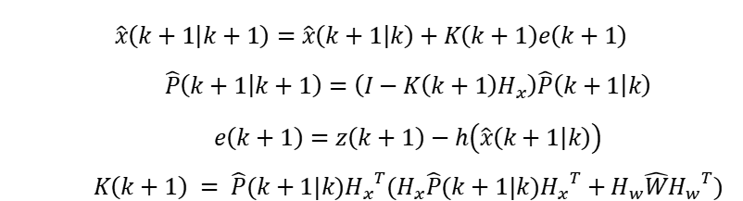

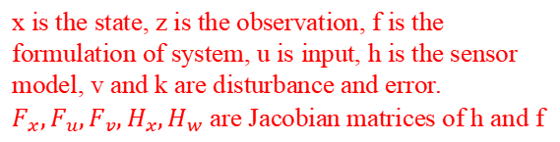
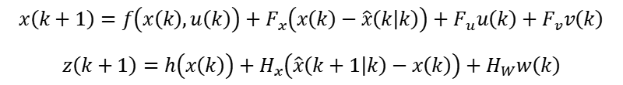

3. Methods, Toolbox and Software
Methods
x is the state, z is the observation, f is the formulation of system, u is input, h is the sensor model, v and k are disturbance and error. $F_{x},F_{u},F_{v},H_{x},H_{w}$ are Jacobian matrices of h and f
Extend Kalman Filter: an optimal state estimation with Gaussian distribution assumption for errors.
System formulation:
Locally linearization for using Kalman Filter:
Taylor
Series
$$x\left(k+1\right)=f\left(x\left(k\right),u\left(k\right)\right)+v\left(k\right)$$
$$z\left(k+1\right)=h\left(x\left(k\right)\right)+w\left(k\right)$$
$$x\left(k+1\right)=f\left(x\left(k\right),u\left(k\right)\right)+F_{x}\left(x\left(k\right)−\hat{x}\left(k | k\right)\right)+F_{u}u\left(k\right)+F_{v}v\left(k\right)$$
$$z\left(k+1\right)=h\left(x\left(k\right)\right)+H_{x}\left(\hat{x}\left(k+1 | k\right)−x\left(k\right)\right)+H_{W}w\left(k\right)$$
Two Steps:
Estimation:
Correction with Observation:
$$\hat{x}\left(k+1 | k\right)=f\left(\hat{x}\left(k | k\right),u\left(k\right)\right)$$
$$\hat{P}(k+1|k) = F_{x}\hat{P}(k|k){F_{x}}^{T}+F_{v}\hat{V}(k|k){F_{v}}^{T}$$
$$\hat{x}\left(k+1 | k+1\right)=\hat{x}\left(k+1 | k\right)+K\left(k+1\right)e\left(k+1\right)$$
$$\hat{P}\left(k+1 | k+1\right)=\left(I−K\left(k+1\right)H_{x}\right)\hat{P}\left(k+1 | k\right)$$
$$e\left(k+1\right)=z\left(k+1\right)−h\left(\hat{x}\left(k+1 | k\right)\right)$$
$$K\left(k+1\right) = \hat{P}(k+1|k){H_{x}}^{T}(H_{x}\hat{P}(k+1|k){H_{x}}^{T}+H_{w}\hat{W}{H_{w}}^{T})$$
Notes:
For the implementation of EKF in SLAM, the problem is formulated as a state estimation problem and the error is assumed as Gaussian distribution. The state $x$ can have the information of both robot and environment and can be updated by a linearized model with last state. The observation can be used to correct the current state and reduce the enlarging variance.
For a system, we can model as the following form, where x is the state, z is the observation, f is the formulation of system, u is input, h is the sensor model, v and k are disturbance and error. The model can be locally linearized by the first term of Taylor series then the Kalman filter can be used with the following equation, $F_{x},F_{u},F_{v},H_{x},H_{w}$ are Jacobian matrices of h and f.
EKF has mainly two steps: estimation and correction. The estimation is to use the last state and system model to get and estimation of new stage and covariance. The correction is to use the observation to update the estimation with Kalman gain K. Finally, the optimal estimation for the state containing the information of robot and environment can be obtained

Slide 7
3. Methods, Toolbox and Software
Methods
Particle filter: Mont Carlo estimator for states without the assumption of Gaussian distribution.
Initialization: Generate particles with equal weight
Update particles with the model of system and error
Estimate the interpretability of particles
Next Step
Choose the better particles to nest step
Update the weight to choose particles
Notes:
Particle filter is an algorithm that try to get a state that can explain the environment data, it can be used without the assumption that the distribution of error is Gaussian distribution
In this algorithm, the particles are initialized randomly and with the same weight to be chosen, then the particles will go to be updated and resampling in each step. The update of particles can be used by the model of the system then the evaluation for particle can be error form observation. The next step is to update the weight of the particle can be chosen and choose the particles to next stage that can explain better on the observation with the weight.

Slide 8
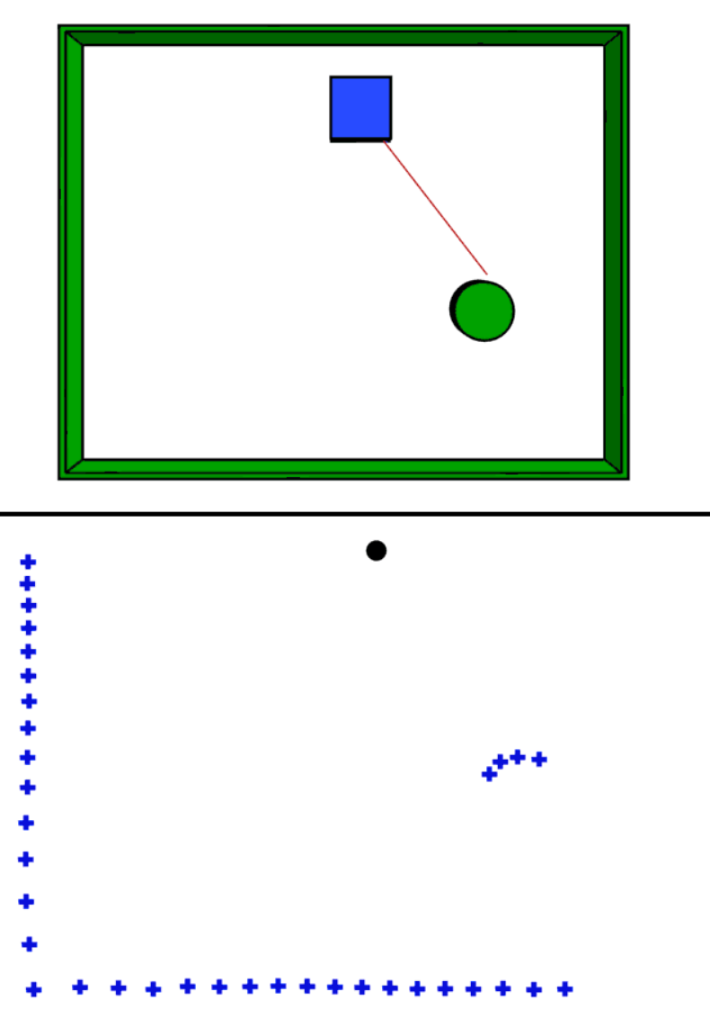
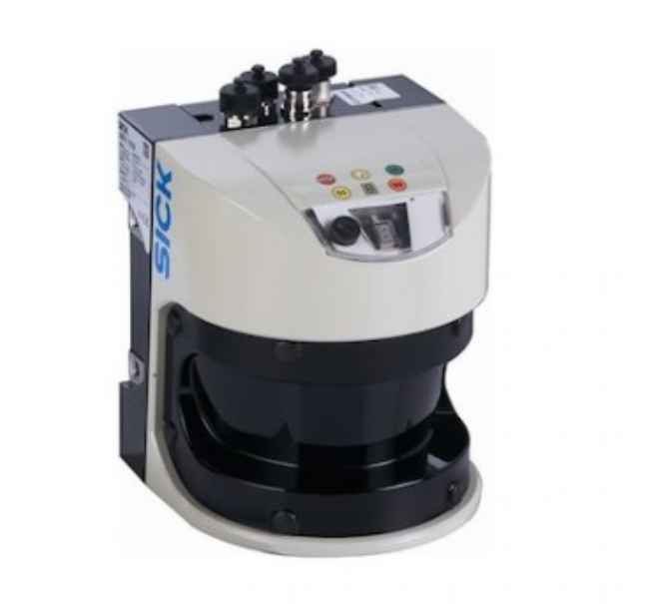
3. Methods, Toolbox and Software
Methods
Lidar
Lidar is a method for determining ranges (variable distance) by targeting an object or a surface with a laser.
Notes:
As for the SLAM problem we try to solve, we implement localization and mapping based on the data collected by Lidar scan. Lidar is a method for determining ranges (variable distance) by targeting an object or a surface with a laser. It outputs relative angle and corresponding distance from obstacles, once the obstacle points are drown in a coordinate, they can form PointNet.
pointNet describes geometry characteristics of obstacle surface.

Slide 9
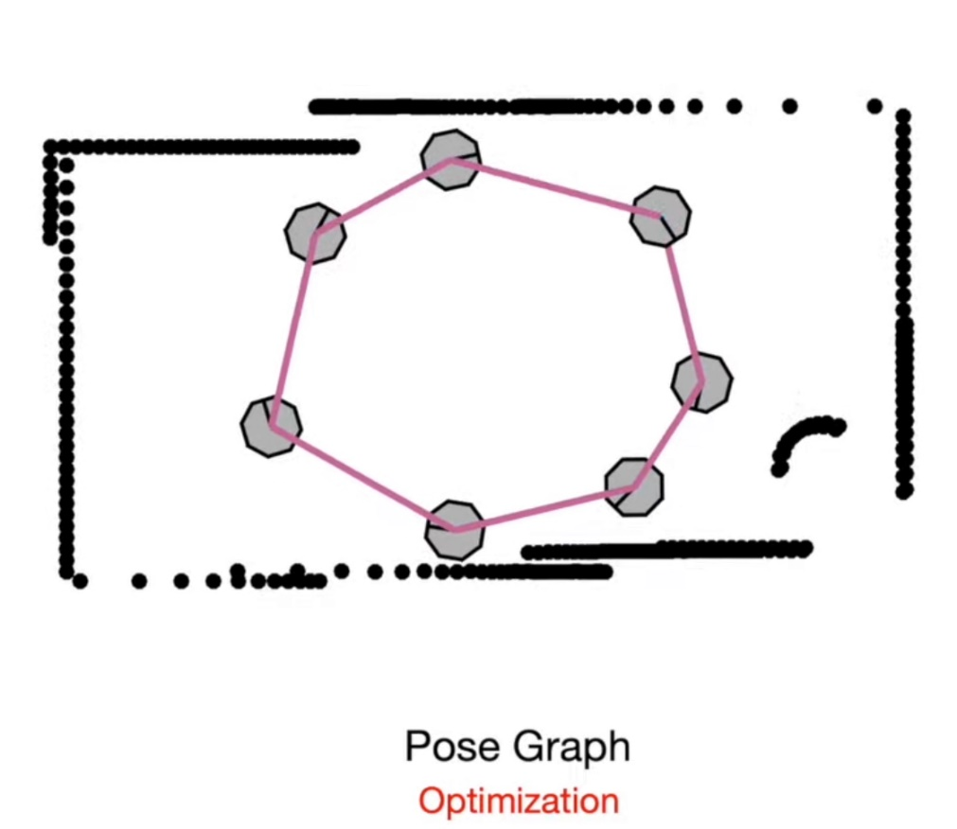
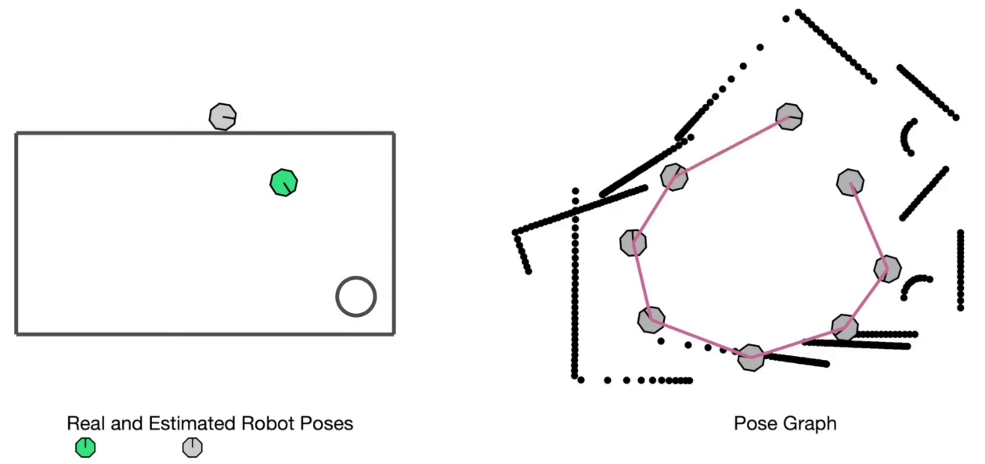
3. Methods, Toolbox and Software
Methods
Pose Graph Optimization
close loop detection -> close loop correction
Notes:
Pose Graph Optimization is a popular framework for solving the simultaneous localization and mapping (SLAM) problem in autonomous navigation.
The visual SLAM system will accumulate errors with the lack of external control information. To solve such problems, we use the pose graph optimization based Close Loop Enclosure method.
This method has two steps:
1. Close loop detection (match scan frames based on frame feature extraction)
2. Close loop correction (reduce local cumulative error [Loop fusion: fuse the map points & eliminate the duplicate map points] [perform the pose correction of the current frame] [perform pose correction of all frames])

Slide 10

3. Methods, Toolbox and Software
Toolbox
Navigation Toolbox™ provides algorithms and analysis tools for motion planning, simultaneous localization and mapping (SLAM), and inertial navigation.

Slide 11
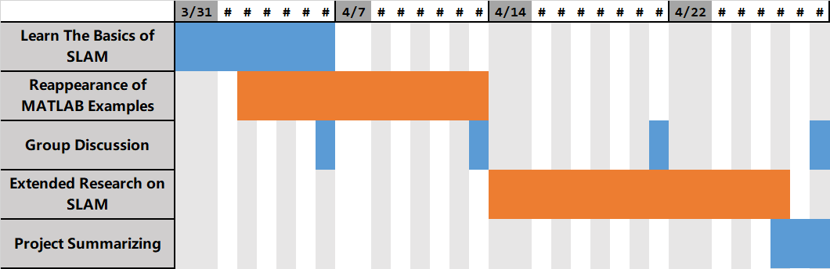
4. Schedule
Gantt Chart
Assignment of Responsibility
- Robot State Estimation —— He Run / Qi Rui
- Environment Map Construction —— Tian Ruoyao / Song Yuchen / Zeng Jialong

Slide 12
Thanks for listening! Q&A

